Slide 1
5K Run Hanoi 2020

Slide 2
Overview
Running event held on Hanoi, Vietnam 2020
Distance 5K
Registered participant 3057 people
Event type: Road Running
Analysis Focus: Race outcome & Participant performance

Slide 3
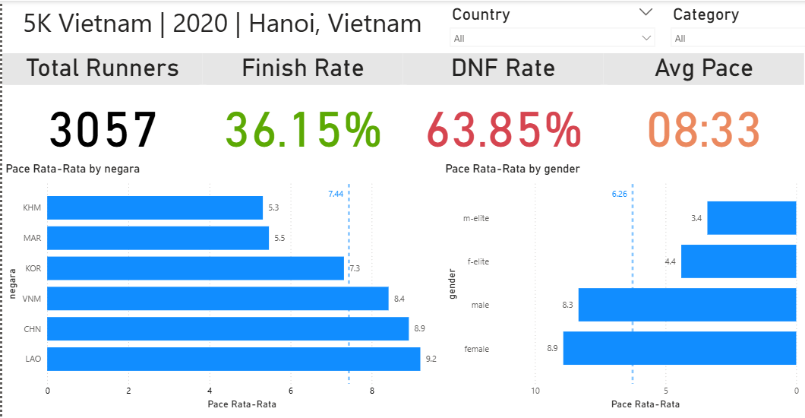

Slide 4
Performance Analysis
Camboda (KHM) has the fastest avg pace 5:18/Km
M-elite runner has the fastest avg pace 3:24/Km
Non elite runner has the avg pace under benchmark > 6:26/Km

Slide 5
Race Outcome
Finisher participant is 36.15% from 3057 participant
63.85% of participant is DNF
Overall Avg pace of the race is 8:33/Km which equal to 42:45

Slide 6
Event Analysis
Avg pace of the event is higher than average pace of all event in Hanoi 7:47/Km
Race condition: High elevation and high humidity
B2C: less RPC -> more DNF (DNS is neglected and equal to DNF)

Slide 7
Recommendation
Venue to be more low elevation because of road running not trail running
Fill the RPC more of useful things
Evaluate more venue that a bit colder and proper for best condition of participant

